Slide 1
Clean Code
Objects and Data structures
Fatemeh Shahidani
July 2020

Slide 2
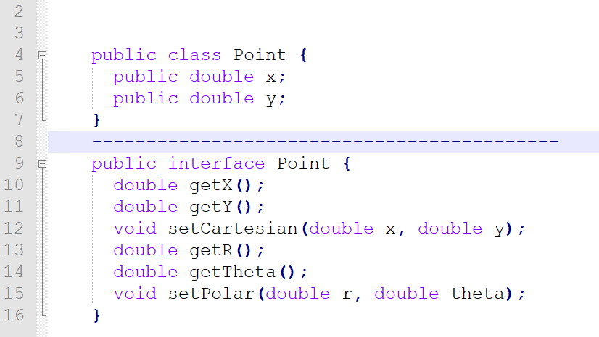
Objects vs Data Structures: Example
Both represent a Point.
But the second one, it represents more than just a data structure.
The methods enforce an access policy.
You can read the individual coordinates independently, but you must set the coordinates together as an atomic operation.

Slide 3
Objects vs Data Structures: Example
The first one, is very clearly implemented in rectangular coordinates
It forces us to manipulate those coordinates independently. This exposes implementation.
Indeed, it would expose implementation even if the variables were private and we were using single variable getters and setters.

Slide 4
Objects vs Data Structures: Example
Hiding implementation is not just a matter of putting a layer of functions between
the variables. Hiding implementation is about abstractions!
we want to express our data in abstract terms. This is not merely accomplished by using interfaces and/or getters and setters.
Serious thought needs to be put into the best way to represent the data that an object contains. The worst option is to blithely add getters and setters.

Slide 5
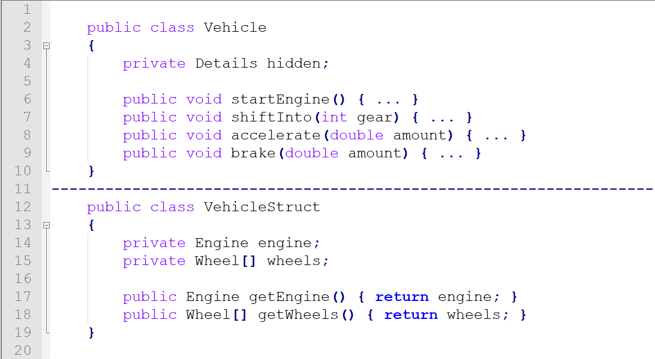
It’s not about getters and setters

Slide 6
It’s not about getters and setters
A user of VehicleStruct knows about the parts a vehicle is made of, and can directly interact with these parts. Behavior, i.e. functions, have to be defined outside of the class. That's why it is easy to change behavior: Adding new functions won't require existing code to change. Changing data, on the other hand, requires changes in virtually every function interacting with VehicleStruct. It violates encapsulation!
The idea behind OOP is to hide the data and expose behavior instead. It focuses on what you can do with a vehicle without having to know if it has engine or how many wheels are installed:

Slide 7
Data/Object Anti-Symmetry
These two examples show the difference between objects and data structures.
Objects hide their data behind abstractions and expose functions that operate on that data.
Data structure expose their data and have no meaningful functions.
They are virtual opposites. This difference may seem trivial, but it has far-reaching implications.

Slide 8
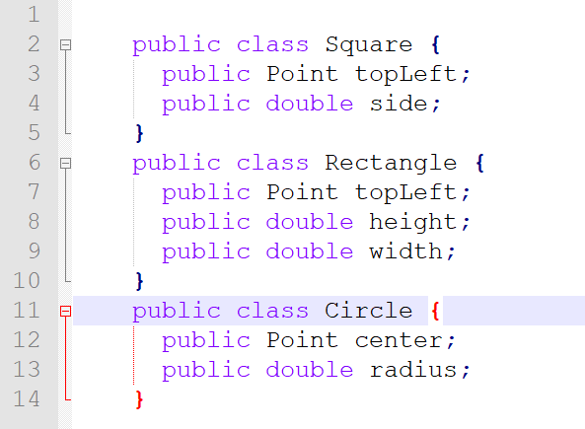
Example: Shape

Slide 9
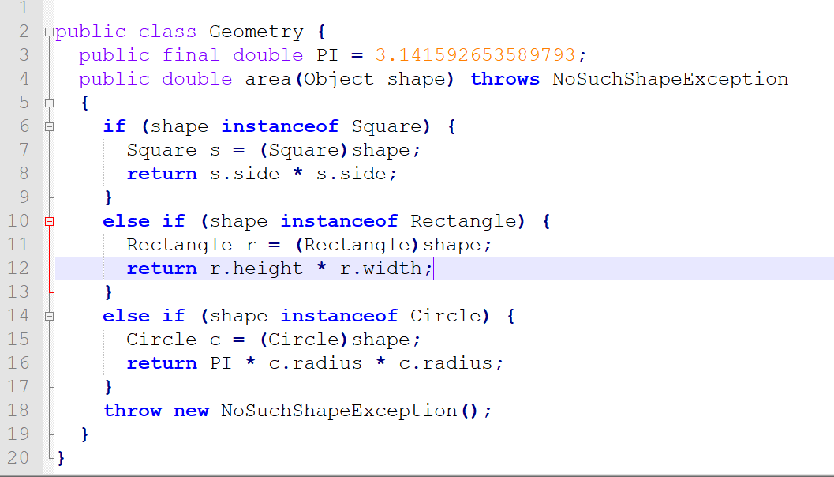

Slide 10
Is it good?
Consider what would happen if a perimeter() function were added to Geometry. The shape classes would be unaffected! Any other classes that depended upon the shapes would also be unaffected!
On the other hand, if I add a new shape, I must change all the functions in Geometry to deal with it. Again, read that over. Notice that the two conditions are diametrically opposed.
Now consider the object-oriented solution. Here the area() method is polymorphic. No Geometry class is necessary.
So if I add a new shape, none of the existing functions are affected, but if I add a new function all of the shapes must be changed!

Slide 11
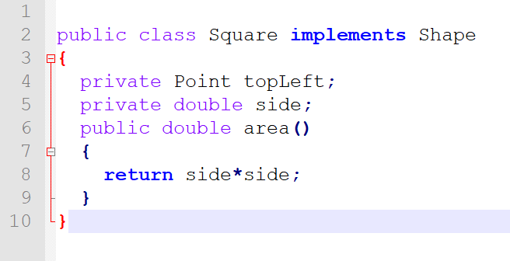
Example: The OOP way

Slide 12
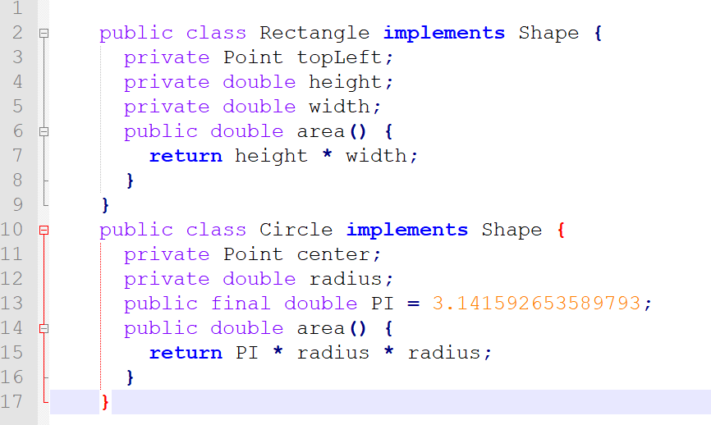

Slide 13
Procedural code vs OO code
Procedural code (code using data structures) makes it easy to add new functions without changing the existing data structures.
Procedural code makes it hard to add new data structures because all the functions must change.
OO code, on the other hand, makes it easy to add new classes without changing existing functions.
OO code makes it hard to add new functions because all the classes must change.

Slide 14
Procedural vs OOP?
In any complex system there are going to be times when we want to add new data types rather than new functions. For these cases objects and OO are most appropriate.
On the other hand, there will also be times when we’ll want to add new functions as opposed to data types. In that case procedural code and data structures will be more appropriate.
Mature programmers know that the idea that everything is an object is a myth. Sometimes you really do want simple data structures with procedures operating on them.

Slide 15
The Law of Demeter
Principle of least knowledge
Says a module should not know about the innards of the objects it manipulates.
Doing so would mean that object A implicitly requires greater knowledge of object B's internal structure.

Slide 16
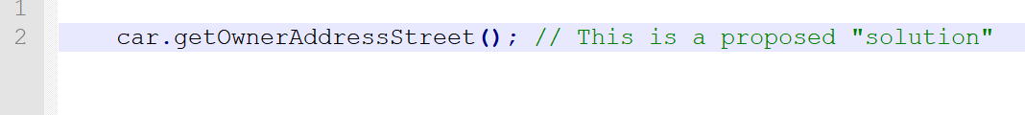
Possible solution: Wrapper function
So two new methods are introduced, but there was no real structural or design change. One could argue that while the Law was technically followed, the spirit of the Law was still violated.
The structure is still visible in the method name, and we all know that the caller wants to get the street of the address of the owner of the car.
The question is: Why does the caller want that, and how does he/she even know that this information exists at this point?
There is a deeper design issue here that needs to be addressed.

Slide 17
Practical solution
The traditional solution to Demeter violations is "tell, don't ask." In other words, based on your state, you should tell a managed object (any object you hold) to take some action -- and it will decide whether to do what you ask, depending on its own state.
The point is to remove the dependency of car on such structure rather than moving the representation of the structure from a sequence of chained methods to the name of the method.
Making methods such as MoveTheLeftHindLegForward() in a Dog class doesn't do anything towards fulfilling Demeter. Instead, call dog.walk() and let the dog handle its own legs.

Slide 18
Feature envy
Feature envy is a term used to describe a situation in which one object gets at the fields of another object in order to perform some sort of computation or make a decision, rather than asking the object to do the computation itself.
As a trivial example, consider a class representing a rectangle. The user of the rectangle may need to know its area. The programmer could expose width and height fields and then do the computation outside of the Rectangle class. Alternatively, Rectangle could keep the width and height fields private and provide a getArea method. This is arguably a better approach.
The problem with the first situation, and the reason it is considered a code smell, is because it breaks encapsulation.
As a rule of thumb, whenever you find yourself making extensive use of fields from another class to perform any sort of logic or computation, consider moving that logic to a method on the class itself.

Slide 19
Conclusion
Objects expose behavior and hide data.
This makes it easy to add new kinds of objects without changing existing behaviors. It also makes it hard to add new behaviors to existing objects.
Data structures expose data and have no signiﬁcant behavior.
This makes it easy to add new behaviors to existing data structures but makes it hard to add new data structures to existing functions. (Geometry class)
Good software developers understand these issues without prejudice and choose the approach that is best for the job at hand.

